Slide 1
Machine Learning
Dimensionality Reduction in R
June 2019

Slide 2
Content
Principal Component Analysis (PCA)
The Curse of Dimensionality
Why reduce dimensionality?
Exploring multivariate data
Getting PCA to work with FactoMineR
PCA with FactoMineR
Explring PCA()
PCA with ade4
Interpreseting and visualizing PCA models
Plotting cos2
Plotting contributions
Biplots and their ellipsoids
Proximinty of variables in a 2-D PCA plot
Advanced PCA & Non-Negative Matrix Factorization (NNMF)
Determining the right number of PCs
The Kaiser-Guttman rule and the Scree test
Parallel Analysis with paran()
Performing PCA on datasets with missing values
Why is mean imputation problematic?
Estimating missing values with missMDA
N-NMF and topic detection with nmf()
Topic detection with N-NMF: Part I
Topic detection with N-NMF: Part II
Trying different N-NMF algorithms
Exploratory Factor Analysis (EFA)
Intro to EFA
EFA’s model
The Humor Styles Questionnaire dataset
Intro to EFA: Data factorability
How factorable is our Dataset?
Move on or step out of EFA?
Extraction methods
EFA with MinRes and MLE
EFA with Principal Axis Factroing
Choosing the right number of factors
Determining the number of factors
Taking the actual decision
Advanced EFA
Interpretation of EFA and factor rotation
Rotating the extracted facotrs
Which rotation method to choose?
Interpretation of EFA and path diagrams
Interpreting humor styles and visual aid
Humor Styles and hidden factors
EFA: case study
Factorability check
Extracting and choosing the number of factors
Factor rotation and interpretation
Congratulations!
When do we use each method?

Slide 3
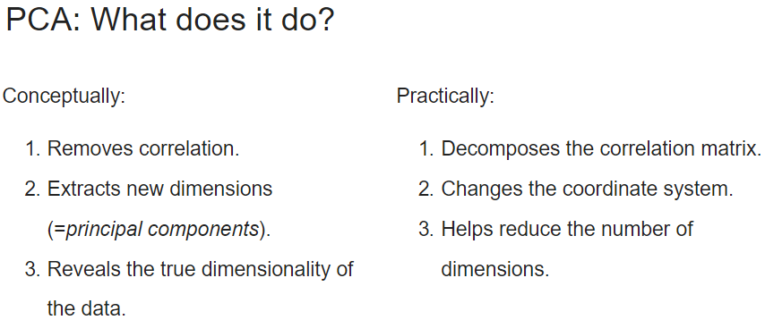
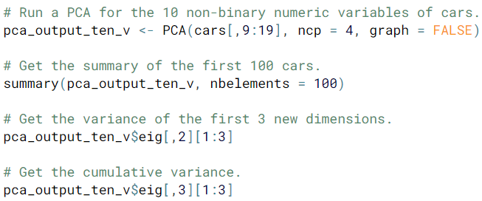
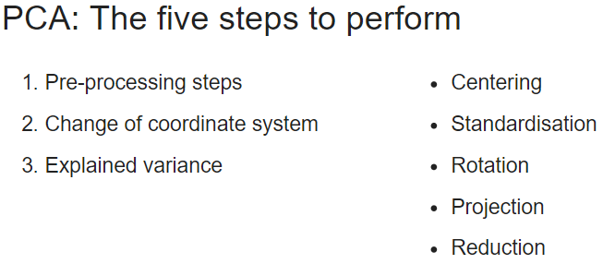
Principal Component Analysis

Slide 4
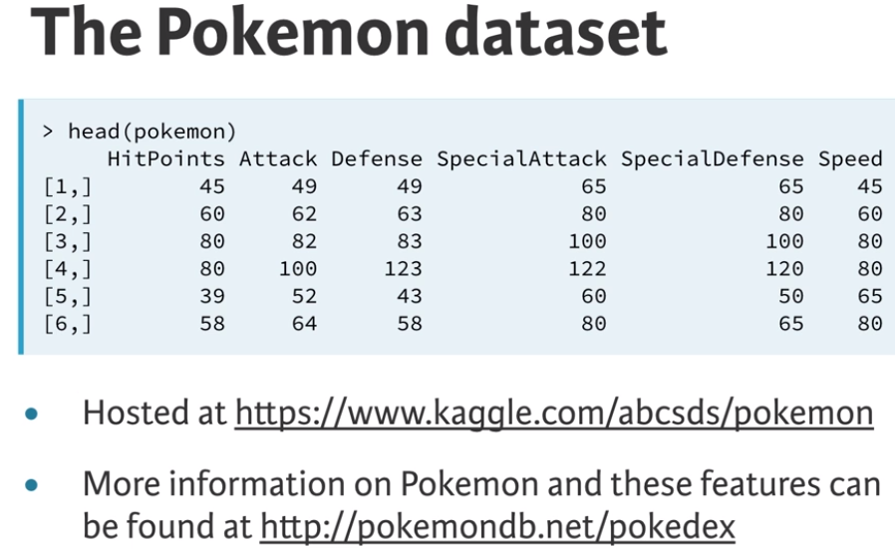
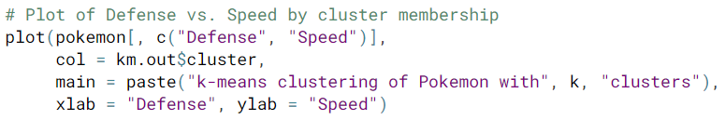
km.out <- kmeans(x, centers = 3, nstart = 20)
summary(km.out)
print(km.out$cluster)
print(km.out)
plot(x, col = km.out$cluster,
main = “k-means with 3 clusters,
xlab = “”, ylab = “”)
par(mfrow = c(2, 3))
set.set(1)
for (i in 1:6) {
km.out <- kmeans(x, centers = 3, start = 1, iter.max = 50)
plot(x, col = km.out$cluster,
main = km.out$tot.withinss,
xlab = “”, ylab = “”)
}
wss <- 0
for (i in 1:15) {
km.out <- kmeans(x, centers = i, nstart = 20)
wss[i] <- km.out$tot.withinss
}
plot(1:15, wss, type = “b”,
xlab = “Number of Clusters”,
ylab = “Within groups sum of squares”)
Model Selection
k-means has a random component
best outcome is based on total within cluster sum of squares
If you don’t know the number of clusters in advance and need to determine it, you’ll have to run the algorithm multiple times with differing number of clusters. From these iterations, you can observe how model quality changes with the number of clusters. A scree plot is used for this purpose.
sum of the squared (Euclidean) distance for each observation with each cluster
best outcome is the minimum of this metric
available components
cluster, centers, totss, withinss, tot.withinss
betweenss, size, iter, ifault
Data Challenges
Selecting the variables to cluster upon
Scaling the data
Determining the number of clusters
Visualize the results for interpretation
Unsupervised Learning in R

Slide 5
In hierarchical clustering, the first step is to determine the similarity between observations by using the dist() function.
hclust.out <- hclust(dist(x))
summary(hclust.out)
cutree(hclust.out, h = 7)
cutree(hclust.out, k = 3)
hclust.complete <- hclust(dist(x), method = “complete”)
hclust.average <- hclust(dist(x), method = “average”)
hclust.single <- hclust(dist(x), method = “single”)
colMeans(pokemon)
apply(pokemon, 2, sd)
pokemon.scaled <- scale(pokemon)
hclust.pokemon <- hclust(dist(pokemon.scaled), method = “complete”)
cut.pokemon <- cutree(hclust.pokemon, k = 3)
Compare → km.pokemon$cluster to cut.pokemon
cuts the dendrogram at a height of 7
cuts the dendrogram at a height at which 3 clusters form
The choice of linkage method can result in balanced (even number of observations assigned to each cluster) or unbalanced trees. The nature of the tree that is desired depends on the context of the problem you’re trying to solve. Unbalanced trees are desirable when outlier detection is important because pruning an unbalanced tree can result in most observations assigned to one cluster and only a few observations assigned to other clusters.
cluster linkage methods
Hierarchical Clustering

Slide 6
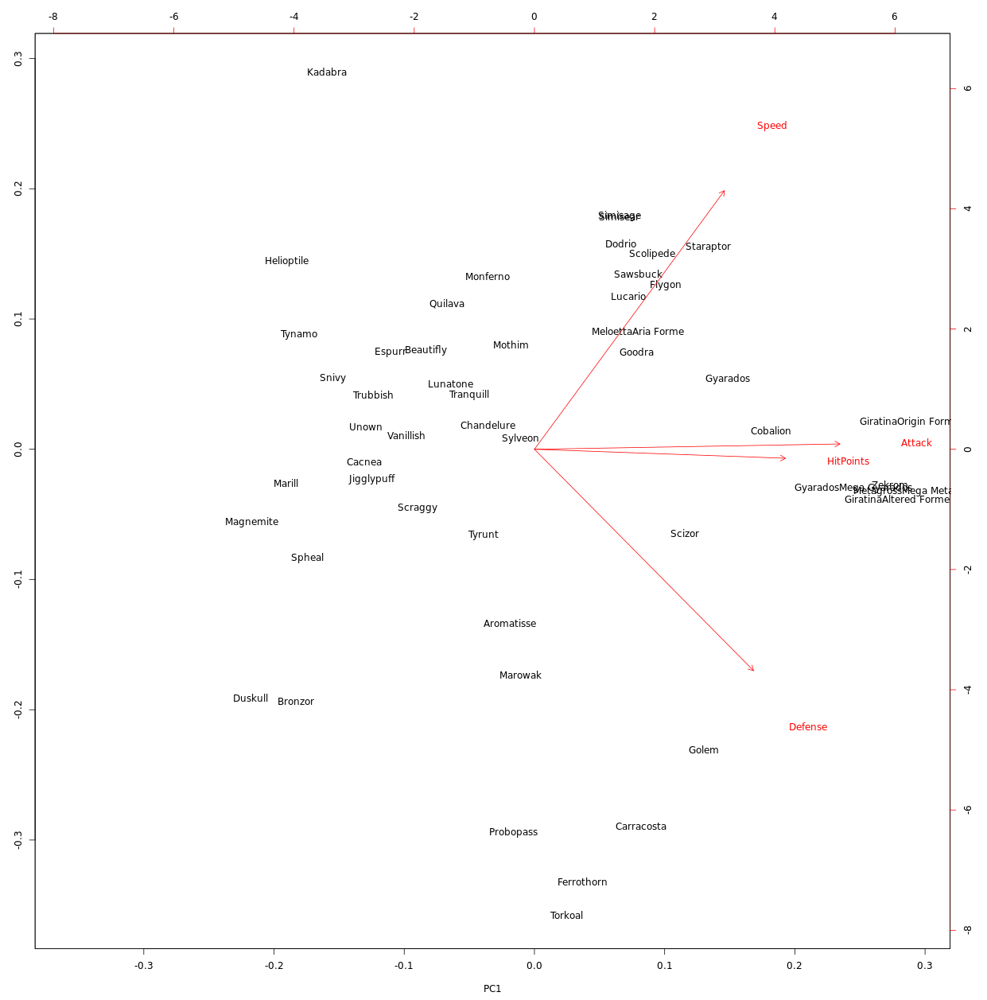
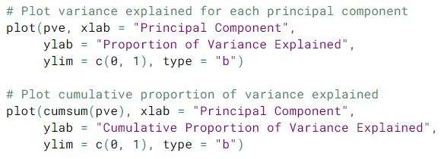
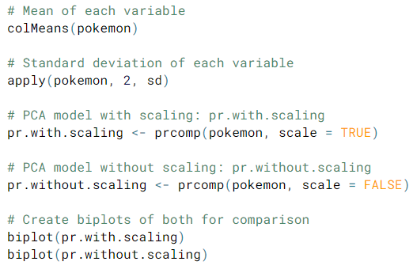
Dimensionality Reduction has two main goals – (1) find structure in features and (2) aid in visualization.
Principal Component Analysis (PCA) is a popular method for dimensionality reduction with three main goals – (1) find linear combination of variables to create principal components, (2) maintain the most variance in the data, and (3) derive uncorrelated (orthogonal) principal components.
pr.out <- prcomp(pokemon, scale = TRUE)
summary(pr.out)
PCA models in R produce additional diagnostics and output components:
center, scale, rotation, and x
Each of these components can be accessed using $ <- pr.out$rotation
biplot(pr.out)
pr.var <- pr.out$sdev ^ 2
pve <- pr.var / sum(pr.var)
Dimensionality Reduction with PCA

Slide 7
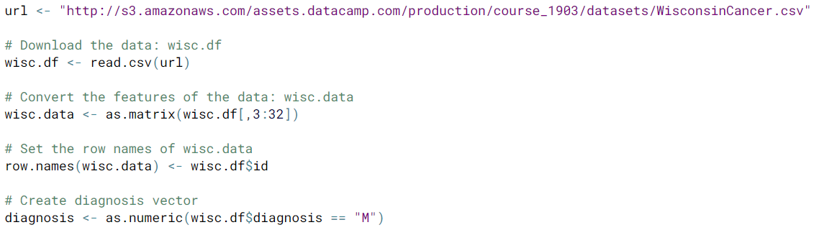
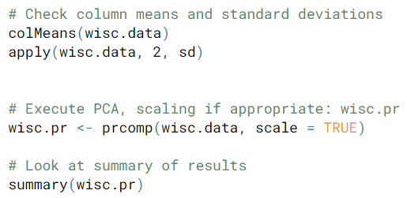
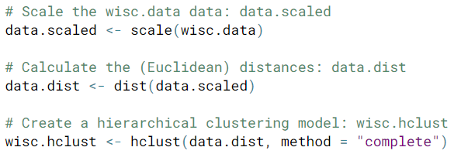
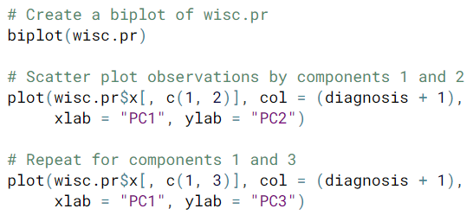
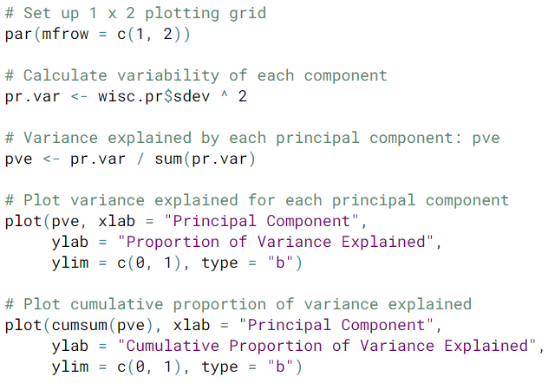
Overall Steps
Download data and prepare data for modeling
Exploratory data analysis
Perform PCA and interpret results
Complete two types of clustering
Understand and compare the two types
Combine PCA and clustering
Putting It All Together with a Case Study

Slide 8
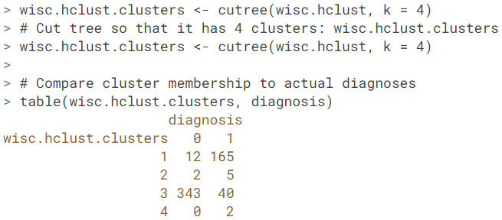
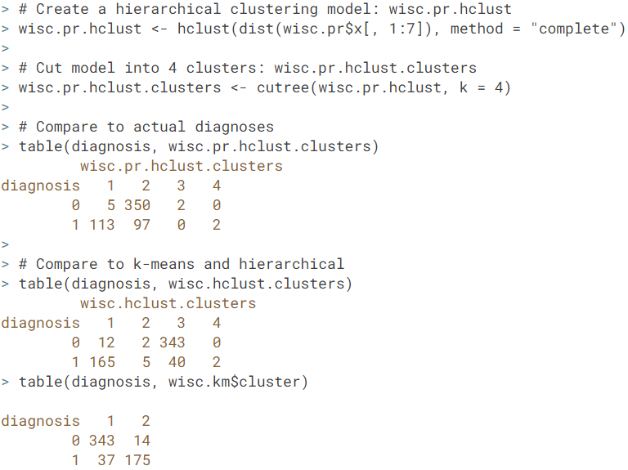
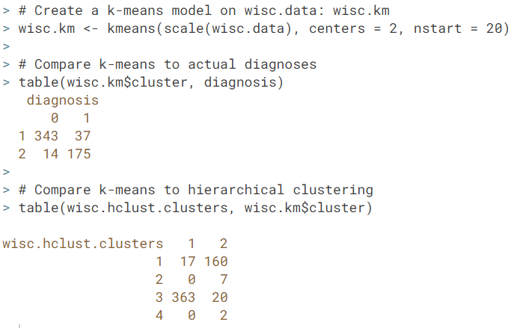
When a target variable (label) is available, you can compare the outputs from your hierarchical clustering model to observation labels in order to check the performance of the clustering model. When performning supervised learning – that is, when you’re trying to predict some target variable of interest and that target variable is available in the original data – using clustering to create new features may or may not improve the performance of the final model.

